Slide 1



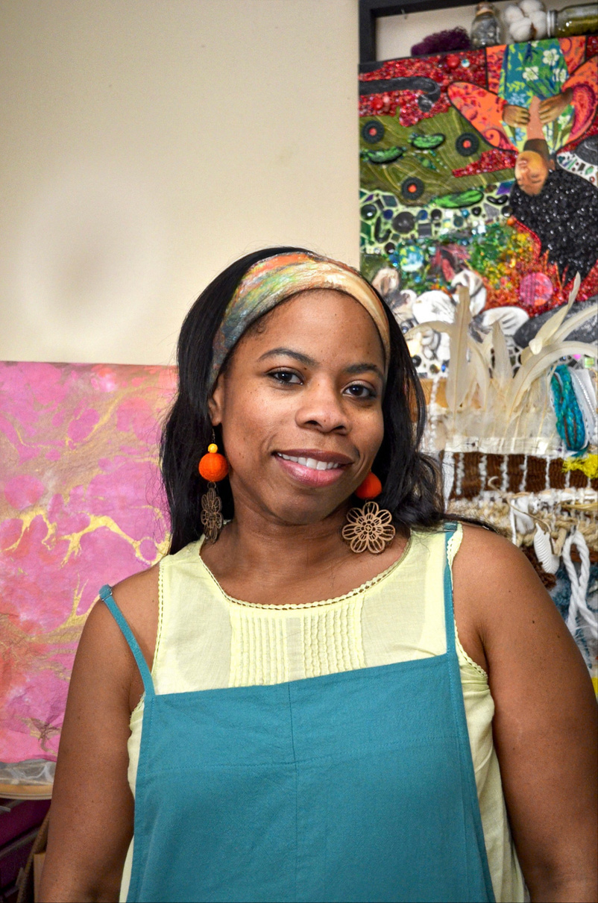
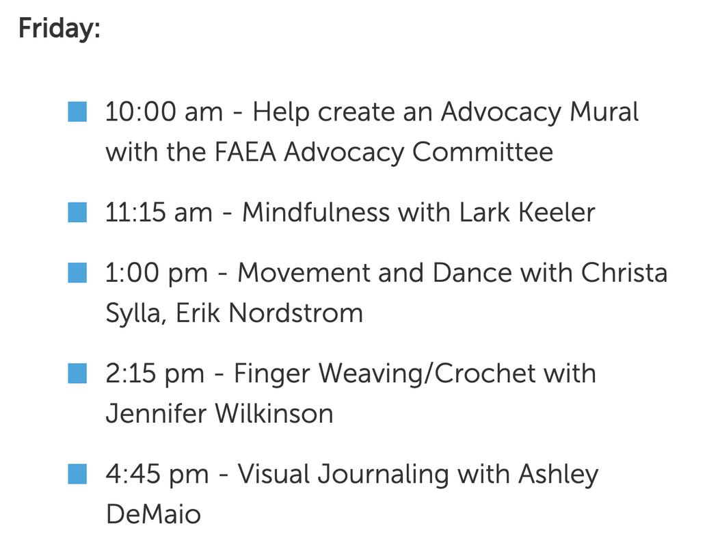
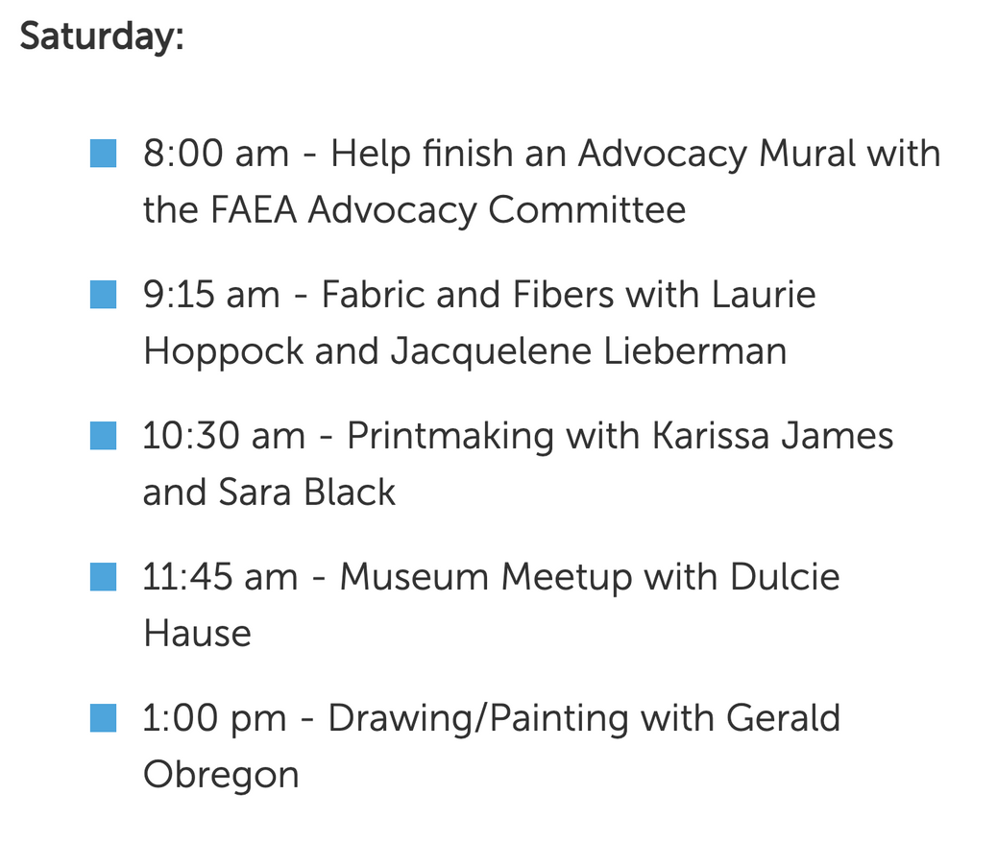


The Artful Happenings Rooms
Free! Fun! Community Building! Come Join US!!
Please stop by the Artful Happenings Room at a time that aligns with your interest to meet and commune with other members that share your interests.

